Slide 1

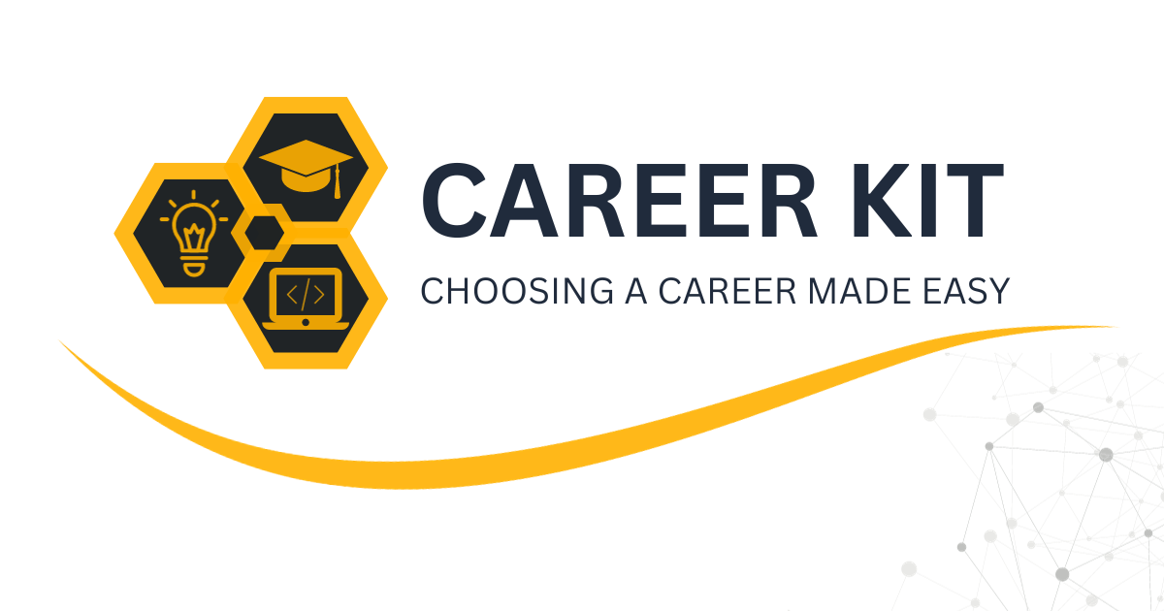
AI Career Advisor: Guiding Students to Success
This presentation explores the development of an AI-powered career advisor, designed to help students make informed decisions about their future.

Slide 2
The Challenge of Choosing a Career
Real-World Scenario
AI Career Advisor
Have you ever struggled to choose the right career? What if AI could guide students to make the best decision?
This project introduces an AI-powered career advisor, leveraging the power of AI and ML to provide personalized guidance.

Slide 3

Project Goals: Empowering Students
1
Predict Best Career Stream
2
Provide AI-Powered Advice
Identify the most suitable career path based on student preferences and abilities.
Offer personalized career recommendations using AI insights and data analysis.
3
Help Students Make Informed Decisions
Empower students to make confident choices about their future careers.

Slide 4

Target Audience: Reaching Out to Students
10th-Grade Students
Parents & Educators
Career Counselors
Students at a crucial stage of deciding their career path.
Seeking AI-driven guidance for their children's career development.
Looking for a tech-based advisory tool to enhance their services.

Slide 5




The Problem: Challenges in Career Guidance
Many students choose careers based on peer pressure or lack of awareness.
Manual career counseling is time-consuming and subjective.
Mismatch between student interests and chosen fields.

Slide 6

Solving Real-World Problems with AI
Unbiased Recommendations
Personalized Guidance
AI provides objective career suggestions based on data and student profiles.
AI-generated advice tailored to individual student preferences and abilities.
1
2
3
Reduces Uncertainty
Data-driven insights help students understand their strengths and potential career paths.

Slide 7





Scope & Future Enhancements
Expansion to More Career Streams
Include a wider range of career fields, such as Engineering, Law, Design, etc.
University Database Integration
Connect with university databases for course recommendations and program information.
Resume & Skill-Based Analysis
Analyze resumes and skills to predict future job roles and career progression.
AI-Driven Mentorship Programs
Develop AI-powered mentorship programs to connect students with industry professionals.

Slide 8



Revenue Generation: Making the Project Sustainable
Subscription Plans
2
Offer subscription plans for schools and coaching institutes.
Freemium Model
1
Basic career prediction is free, advanced AI advice is paid.
Advertising & Partnerships
Collaborate with EdTech platforms for advertising and partnerships.
3

Slide 9
Dataset & Data Collection: Building the Foundation
Data Sources
Key Features
Public datasets (e.g., Kaggle, UCI), surveys & reports from career counseling websites, synthetic data.
Hobbies & interests, part-time job experience, weekly self-study hours, subject scores, analytical thinking & reasoning, preferred learning method.

Slide 10

Machine Learning Models: Powering the AI Engine
1
Decision Tree
Easy to interpret career choices.
2
SVM
Better classification accuracy.
3
Random Forest
Handles complex data patterns.
4
Clustering
Identifies student groups with similar interests.

Slide 11




System Architecture: Data Collection and Preprocessing
Data Sources
Collection of student data. Includes academic records and interests.
Preprocessing
Cleaning and formatting the data. Ensuring quality for model training.
Feature Extraction
Identifying relevant data. Enhancing model performance.

Slide 12
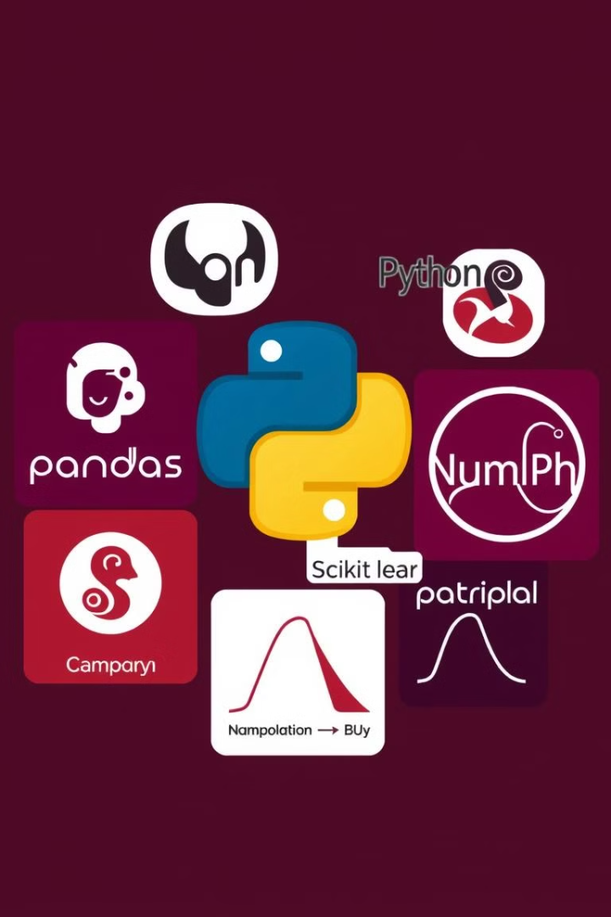
Python Libraries: Pandas, NumPy, Scikit-learn, Matplotlib
Pandas
Used for data manipulation and analysis. Provides data structures.
NumPy
Essential for numerical computations. Used for array operations.
Scikit-learn
Provides machine learning algorithms. Simplifies model development.
Matplotlib
Used for data visualization. Creates informative charts and graphs.

Slide 13





Model Training: RandomForest, Decision Tree, SVM, XGBoost
RandomForest
Decision Tree
SVM
Ensemble learning method. High accuracy and robustness.
Simple and interpretable model. Foundation for complex algorithms.
Effective in high-dimensional spaces. Good for classification tasks.
XGBoost
Optimized gradient boosting. Excellent performance.

Slide 14
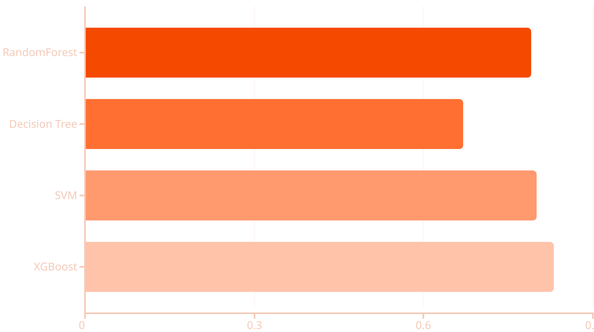
Results: Accuracy and Confusion Matrix for Each Model
88%
74%
85%
86%
The chart displays the models. XGBoost has the highest accuracy.

Slide 15




API Integration: Enhancing Functionality with AI
User Input
1
API Call
2
4
Recommendations
3
AI Analysis
API Integration enhances the guidance system. AI provides personalized career recommendations to the user.

Slide 16
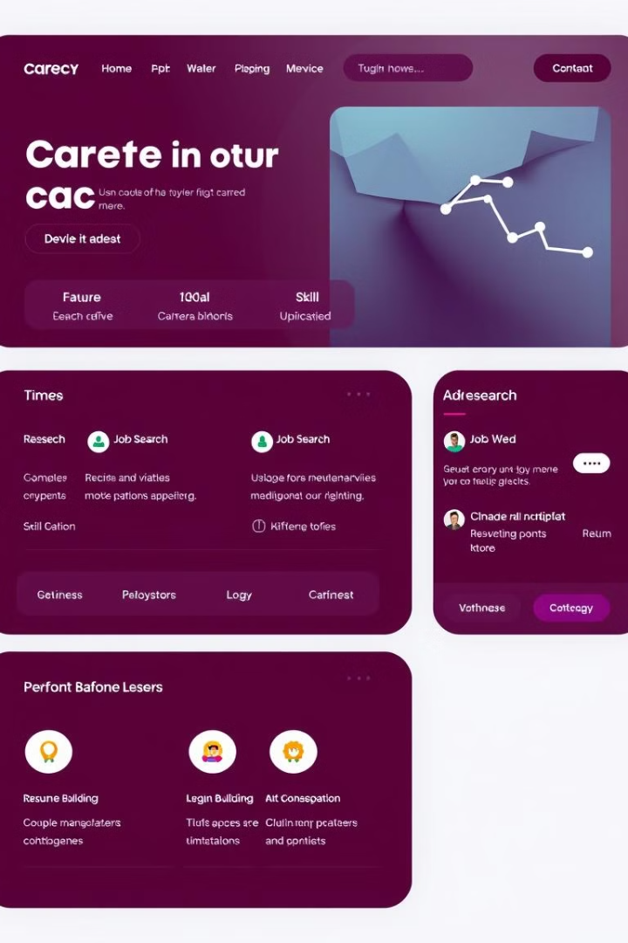
User Interface: A User-Friendly Frontend Design
1
Intuitive Navigation
2
Interactive Elements
Easy-to-use menus and clear labels. Makes exploring options simple.
Engaging queries and assessments. Help students discover interests.
3
Visual Appeal
Modern design and pleasing aesthetics. Creates positive user experience.

Slide 17
Conclusion: Key Findings and Future Directions
Effective Guidance
1
The system provides valuable career advice.
Improved Accuracy
2
Data and training enhanced model accuracy.
Personalized Experience
3
The system makes career planning easier.
The Career Guidance System is highly beneficial. Future work will expand the dataset and improve UI.

Slide 18

Q&A and Further Discussion
Thank you for your attention! Now we open the floor for your questions.

